Slide 1
SATIRE AGAINST HIERARCHICAL SOCIETY
What does it mean for a society to be hierarchical?
A hierarchical system or organization is one in which people have different ranks or positions, depending on how important they are.
Hierarchical societies show great deference and respect to power and authority. They believe in overt manifestations of wealth and power, whereas more egalitarian societies will often intentionally try to blur the power distinction.

Slide 2
INNER PARTY
OUTER PARTY
PROLES

Slide 3
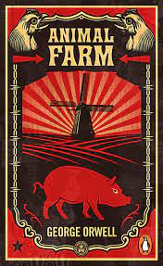
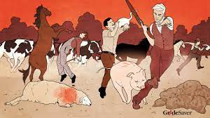
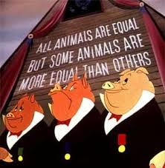
Animal Farm
→ Political satire Novel/Beast Fable
→ A farm in which animals want a rebellion against humans
→ Characters that reflect existing people
→ (Stalin, Marx,, Lenin, Trotsky…)

Slide 4
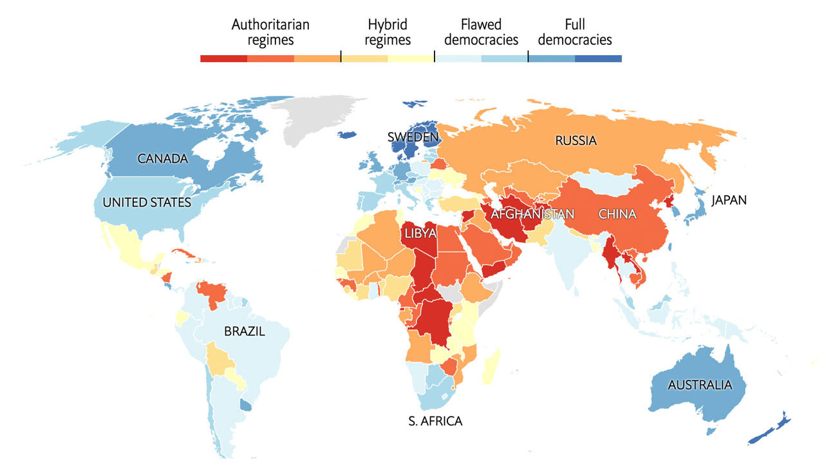
What are the most authoritarian regimes in the world?
SATIRE AGAINST HIERARCHICAL SOCIETY
electoral process and pluralism
functioning of government
political participation
political culture
civil liberties

Slide 5
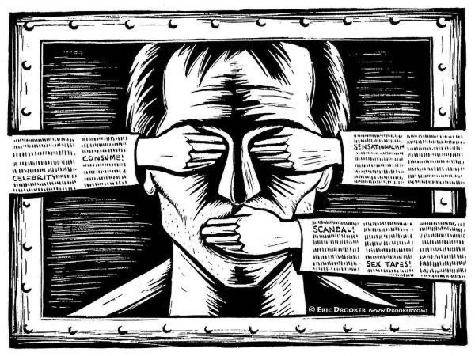
SATIRE AGAINST HIERARCHICAL SOCIETY
How does satire work in authoritarian regimes?

Slide 6
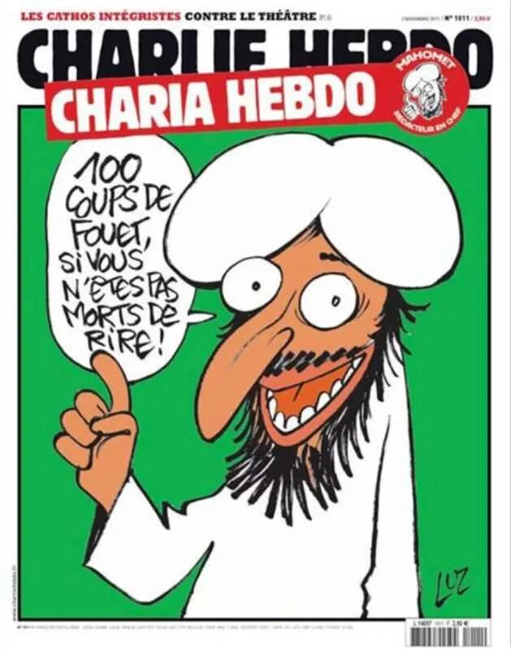
Satire against authoritarian regimes
CHARLIE HEBDO: It is a French satirical weekly, irreverent and provocative, whose critical action is aimed primarily at the defense of individual, civil and collective freedoms, the right to freedom of expression. In recent decades, his satire has targeted Islamic states and for this reason his headquarters have suffered serious terrorist attack in the 2015 with 12 victims. For this reason today the seat of the editorial board is unknown.

